Slide 1

Flow Control and Measurement
Creativity without a trip
Variations on a drip
Giving head loss the slip
Chemical doses that don’t dip
Here’s a tip!
We can use smart fluids to eliminate software, computers, and electronics!

Slide 2
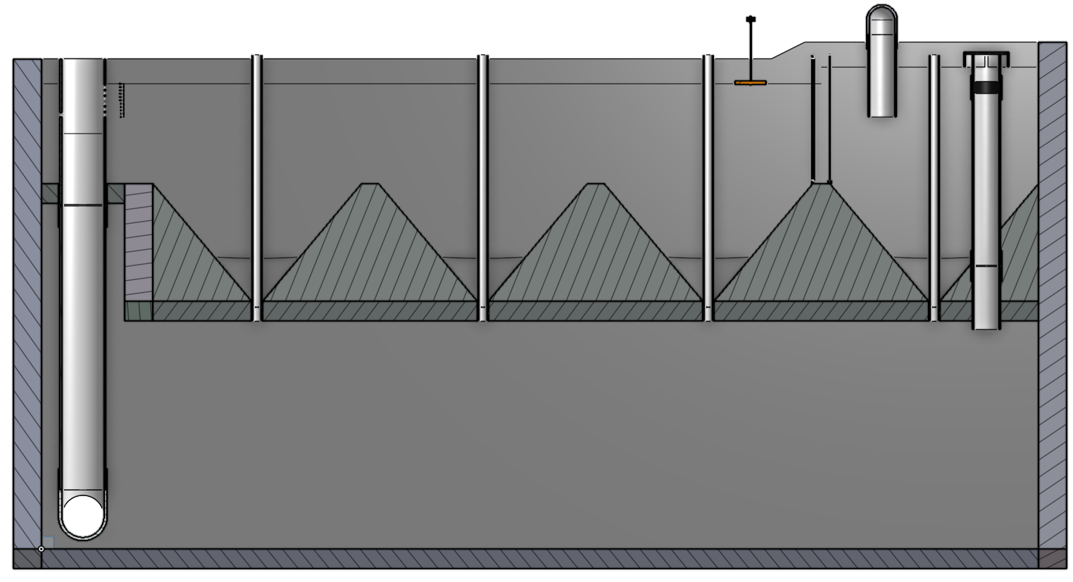
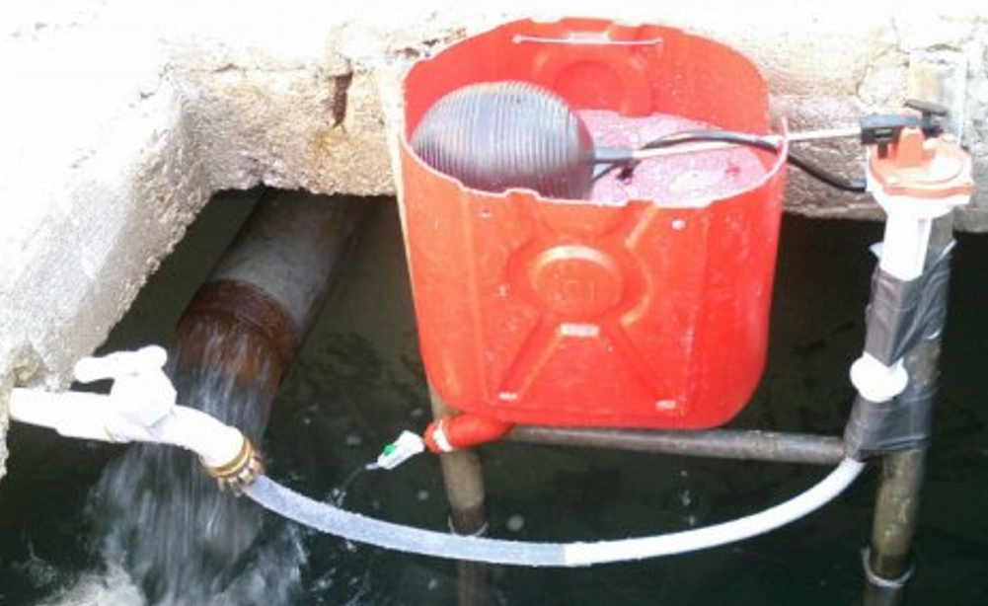
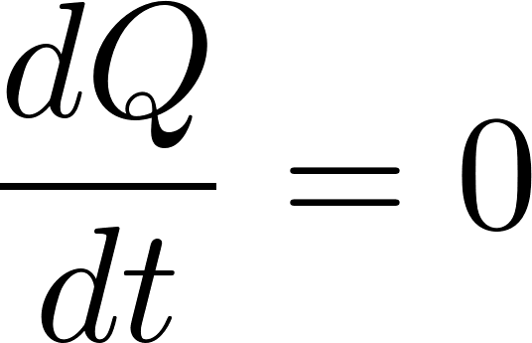

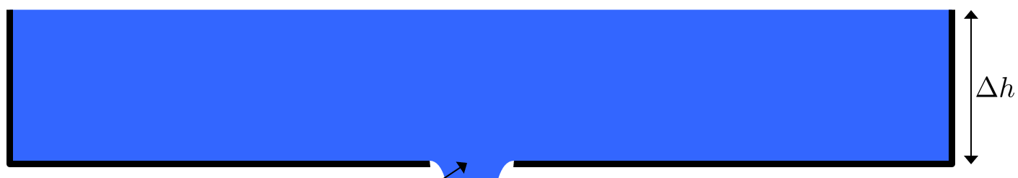


Overview
Entrance Tank
Applications of flow control
If you had electricity
Hole in a bucket
Constant head devices
Floating bowl
Overflow tanks
Marriot bottle
Float valve
Hypochlorinators in Honduras
AguaClara “Almost Linear” Flow Controller
AguaClara Linear Flow Orifice Meter
AguaClara Linear Chemical Dose Controller
Ctrl + click the pictures to go to each section!

Slide 3
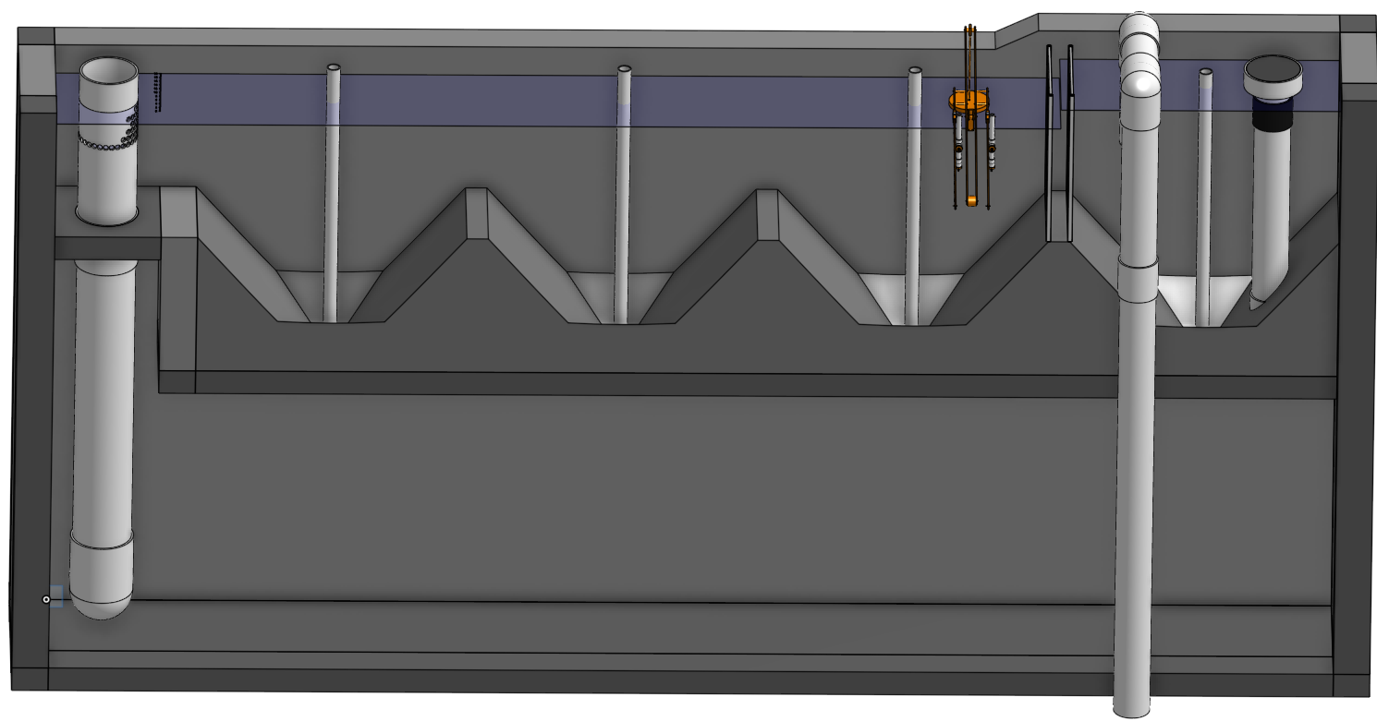
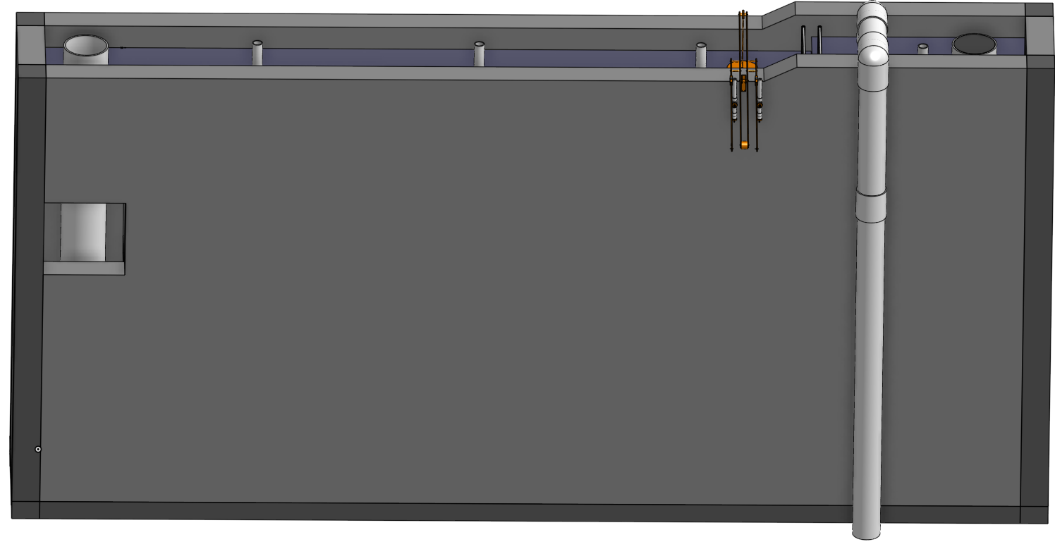

Slide 4
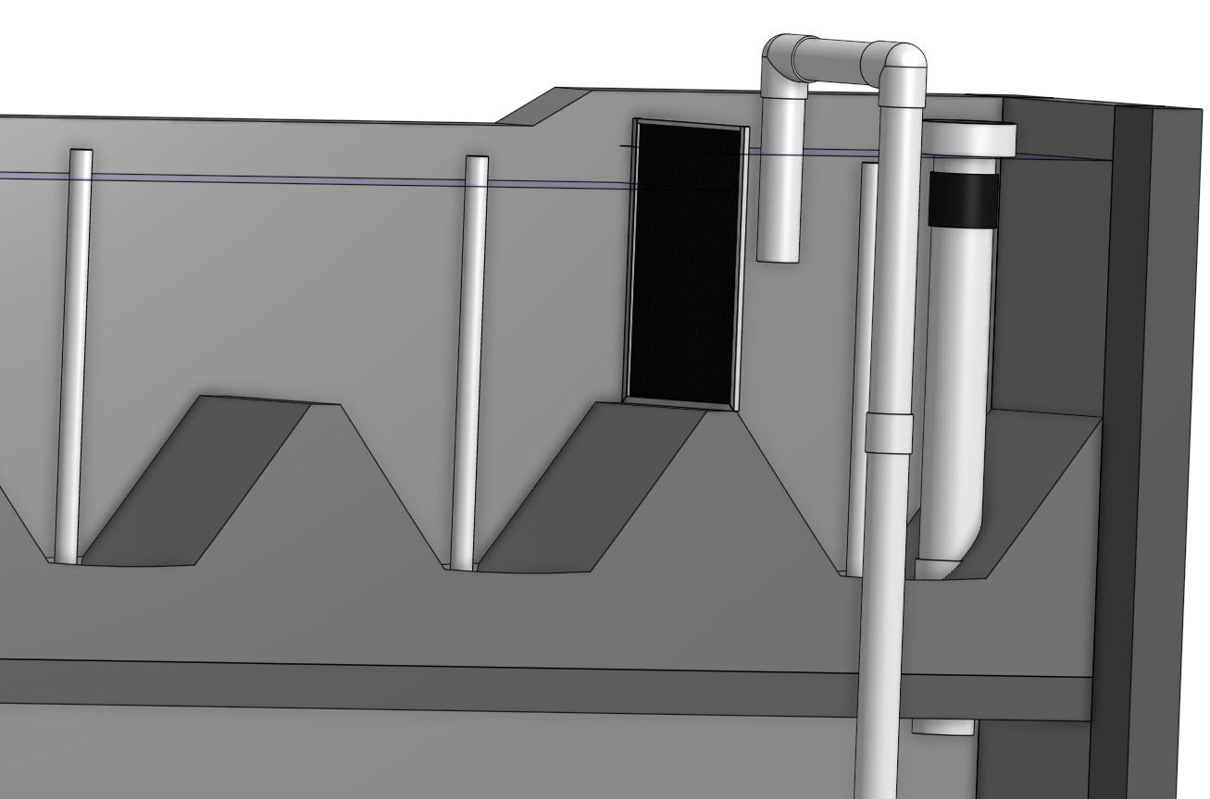

Slide 5
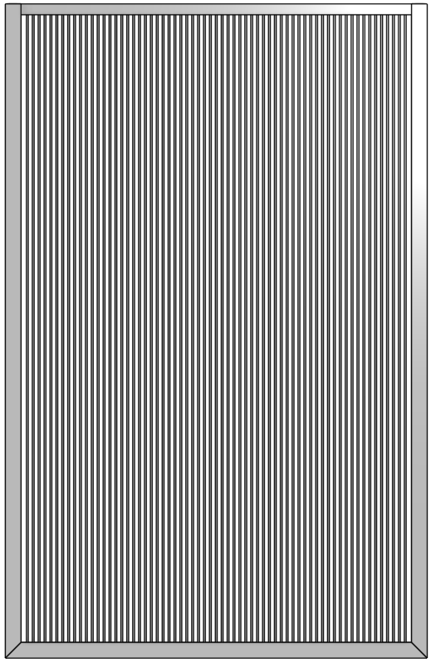
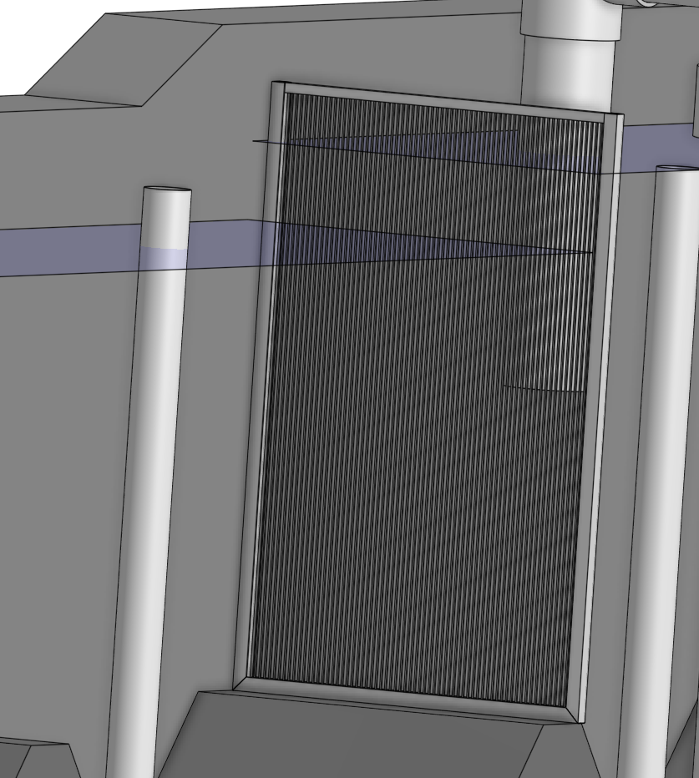
Trash Rack
Protects downstream narrow (3 mm) flow passages
We need a fabrication method!
Designed to handle flow with 90% of the openings clogged!
Physics
Orifice equation
Flow expansion (but Vout is small so orifice equation is reasonable)

Slide 7
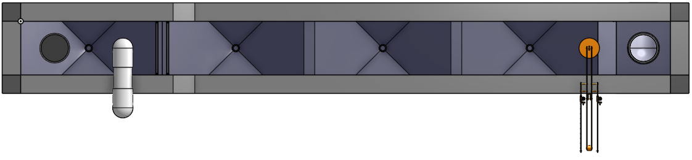
Design Thinking: https://github.com/AguaClara/SWOT/wiki/Design-Thinking
No dimensions are arbitrary! There are ALWAYS constraints that determine the best size
This is true whether it is an evolutionary trait (diameter of your femur) or an engineered device (diameter of a bicycle wheel)
Physics
Economics (or resource efficiency)
Fabrication
Human scaled

Slide 8
Overview
Entrance Tank
Applications of flow control
If you had electricity
Hole in a bucket
Constant head devices
Floating bowl
Overflow tanks
Marriot bottle
Float valve
Hypochlorinators in Honduras
AguaClara “Almost Linear” Flow Controller
AguaClara Linear Flow Orifice Meter
AguaClara Linear Chemical Dose Controller
Ctrl + click the pictures to go to each section!

Slide 9
Applications of Constant Flow
POU treatment devices (Point of Use)
clay pot filters
SSF (slow sand filters)
Arsenic and fluoride removal devices
Reagent addition for community treatment processes
Alum or Poly Aluminum Chloride (PACl) ____________
Calcium or sodium hypochlorite for ____________
Sodium carbonate for _____________
Hydrochloric acid to prevent ______________________________
coagulation
disinfection
pH control
calcium carbonate precipitation

Slide 10
Overview
Entrance Tank
Applications of flow control
If you had electricity
Hole in a bucket
Constant head devices
Floating bowl
Overflow tanks
Marriot bottle
Float valve
Hypochlorinators in Honduras
AguaClara “Almost Linear” Flow Controller
AguaClara Linear Flow Orifice Meter
AguaClara Linear Chemical Dose Controller
Ctrl + click the pictures to go to each section!

Slide 11




If you had electricity…
Metering pumps (positive displacement)
Pistons
Gears
Peristaltic
Diaphragm
Valves with feedback from flow sensors
So an alternative would be to raise the per capita income and provide RELIABLE electrical service to everyone…
A simpler solution with fewer moving parts would be better!

Slide 12
A couple of observations…
Municipal water treatment often fails due to unreliable chemical dosing of chlorine and coagulants
Failure modes include
Inability to easily set the target dose
Lack of easy method for operators to monitor flow
Poor designs that don’t maintain a constant dose

Slide 13

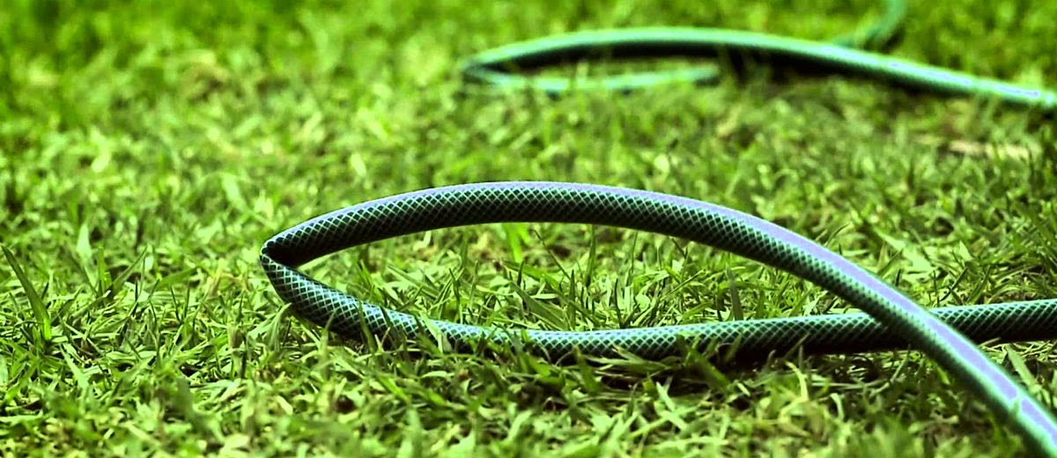
What caused this innovation?
Conscientious operators
Resourceful technicians

Slide 14
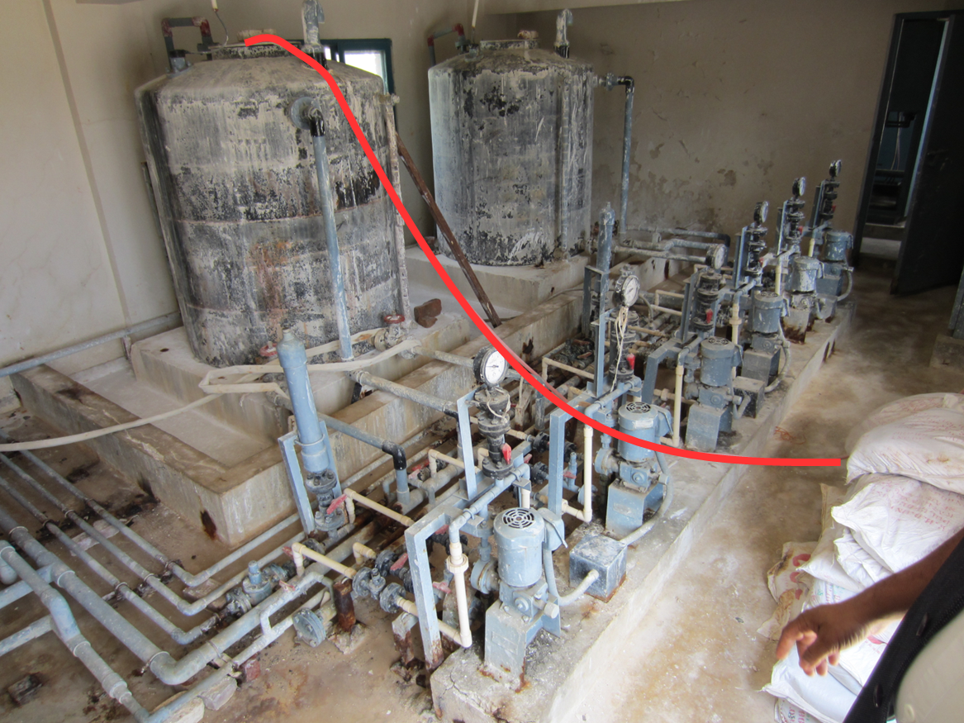
Kinked tube chlorinator
Pro
Con
Simple
Low cost
Available at a local hardware store
No moving parts
Trial and error required to set the chlorine dose
Adjusting the dose is tedious because you have to rewrap the string around the kinked end of the tube to either tighten or loosen the kink
Flow rate (and dose) slowly decreases as the chlorine tank empties
Starting the siphon is hazardous

Slide 15

Dosing at a large city Water Treatment Plant in Asia
One 25 kg block of alum at a time
Placed in the channel carrying raw water into the plant

Slide 16

Salt water electrolytic chorine generators

Slide 17

Chlorine tablet chlorinators
Notes:
We notice that water treatment plants are failing because of poor control of chemical feeds.
We could conclude that the solution is to provide a better supply chain for fixing pumps.
AguaClara is taking a different route.
Let’s invent technologies that are more robust and that can be more easily maintained.

Slide 18
Overview
Entrance Tank
Applications of flow control
If you had electricity
Hole in a bucket
Constant head devices
Floating bowl
Overflow tanks
Marriot bottle
Float valve
Hypochlorinators in Honduras
AguaClara “Almost Linear” Flow Controller
AguaClara Linear Flow Orifice Meter
AguaClara Linear Chemical Dose Controller
Ctrl + click the pictures to go to each section!

Slide 19


Slide 20

The Challenge of Chemical Metering (Hypochlorinator)
What happens to the chlorine flow rate over time?
Access door to hypochlorinator tank
Overflow tube
Chlorine solution
Access door to distribution tank
PVC valve
PVC pipe
Chlorine drip
Raw water entering distribution tank

Slide 21




Hole in a bucket doesn’t give a constant flow rate
Orifice
Vena contracta
Q is flow rate [volume/time]
This is NOT a minor loss coefficient
It is the ratio of the vena contracta area to the orifice area

Slide 22
Finding Q(t) for a tank-valve hypochlorinator [Two unknowns (Q, h)]
Our goal:
To determine the height (h) of chlorine in the tank and its flow rate out of the tank (Q) as a function of time (t)
Tank
h
Valve
Q
Water source pipe

Slide 23



Derived equation for Q(t) through a hypochlorinator

Slide 24
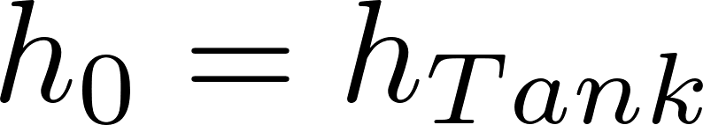


Reflections
Let the discharge to atmosphere be located at the elevation of the bottom of the tank…
When does the flow rate go to zero?
What is the average flow rate during this process if the tank is drained completely?
How could you modify the design to keep Q more constant?

Slide 25

Effect of tank height above valve
Flow rate is almost constant
Case 1:
h₀=50 m
h_{Tank} = 1 m t_{Design}=4 days
Case 2:
h₀=1 m
h_{Tank} = 1 m t_{Design}=4 days

Slide 26
Brainstorm: Constant Flow
Why did the previous systems not provide constant flow of chlorine?
Why is this difficult?
What are the desired properties of the device that meters chemicals into a water treatment plant?
We need constant head as the chemical stock tank empties
Elegant simplicity with few moving parts
Easy for the operator to set the chemical dose (rather than flow)
Notes:
The varying head from the stock tank is a big problem.
We need a constant head AND the ability for the operator to vary the flow
Elegant simplicity
Few moving parts
Easy for the operator to set the chemical dose (rather than flow)

Slide 27
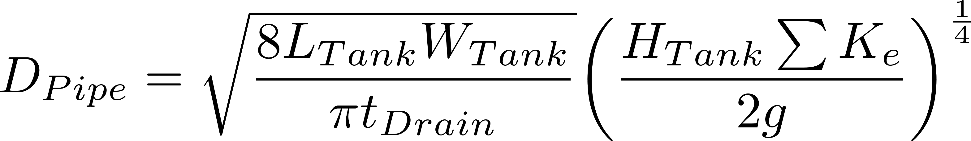
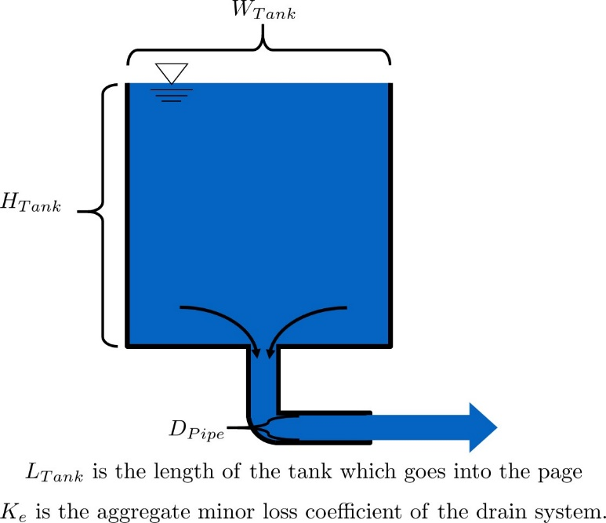
A related tangent… Design a drain system for a flocculator
ΣK_{e} is the sum of all minor loss coefficients for the drain system, including entrance and exit losses and the flow expansion caused by the elbow
*Flocculator highly, highly simplified to show drain

Slide 28
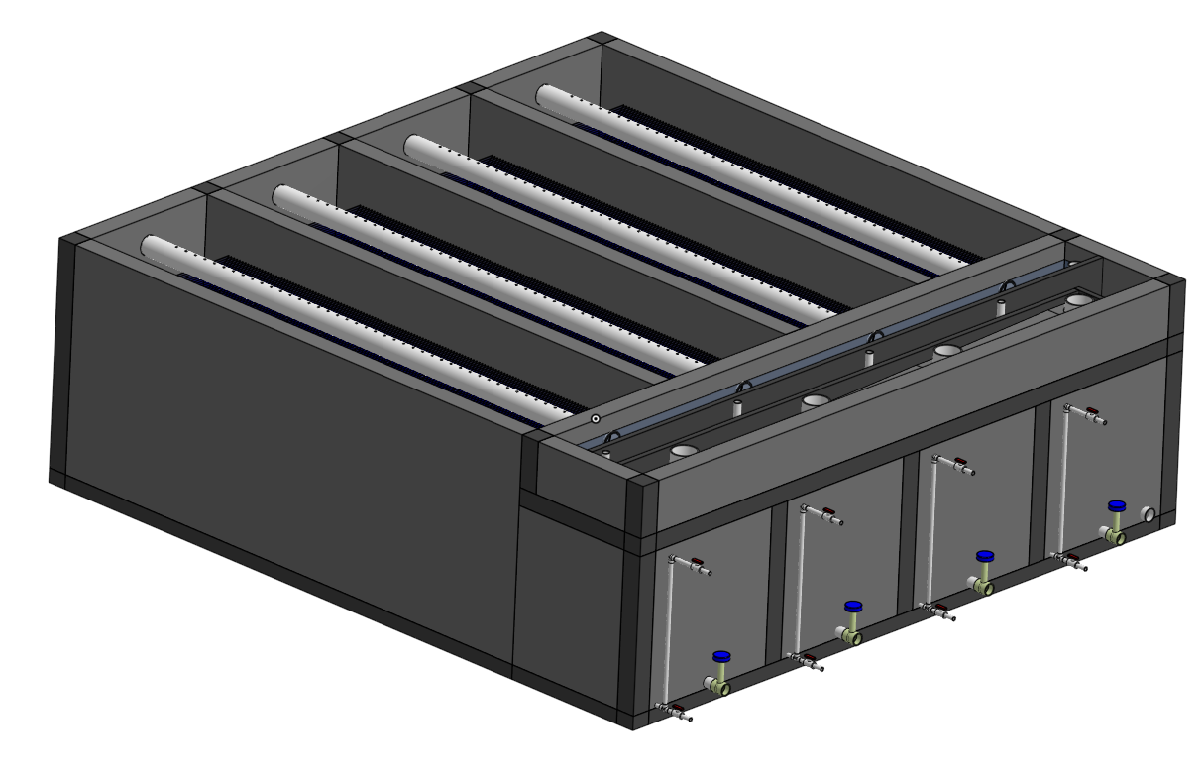
A related tangent… Design a drain system for a sed tank
Sedimentation tank drain has minor losses for entrance, exit, and for the open valve

Slide 29
Overview
Entrance Tank
Applications of flow control
If you had electricity
Hole in a bucket
Constant head devices
Floating bowl
Overflow tanks
Marriot bottle
Float valve
Hypochlorinators in Honduras
AguaClara “Almost Linear” Flow Controller
AguaClara Linear Flow Orifice Meter
AguaClara Linear Chemical Dose Controller
Ctrl + click the pictures to go to each section!

Slide 30
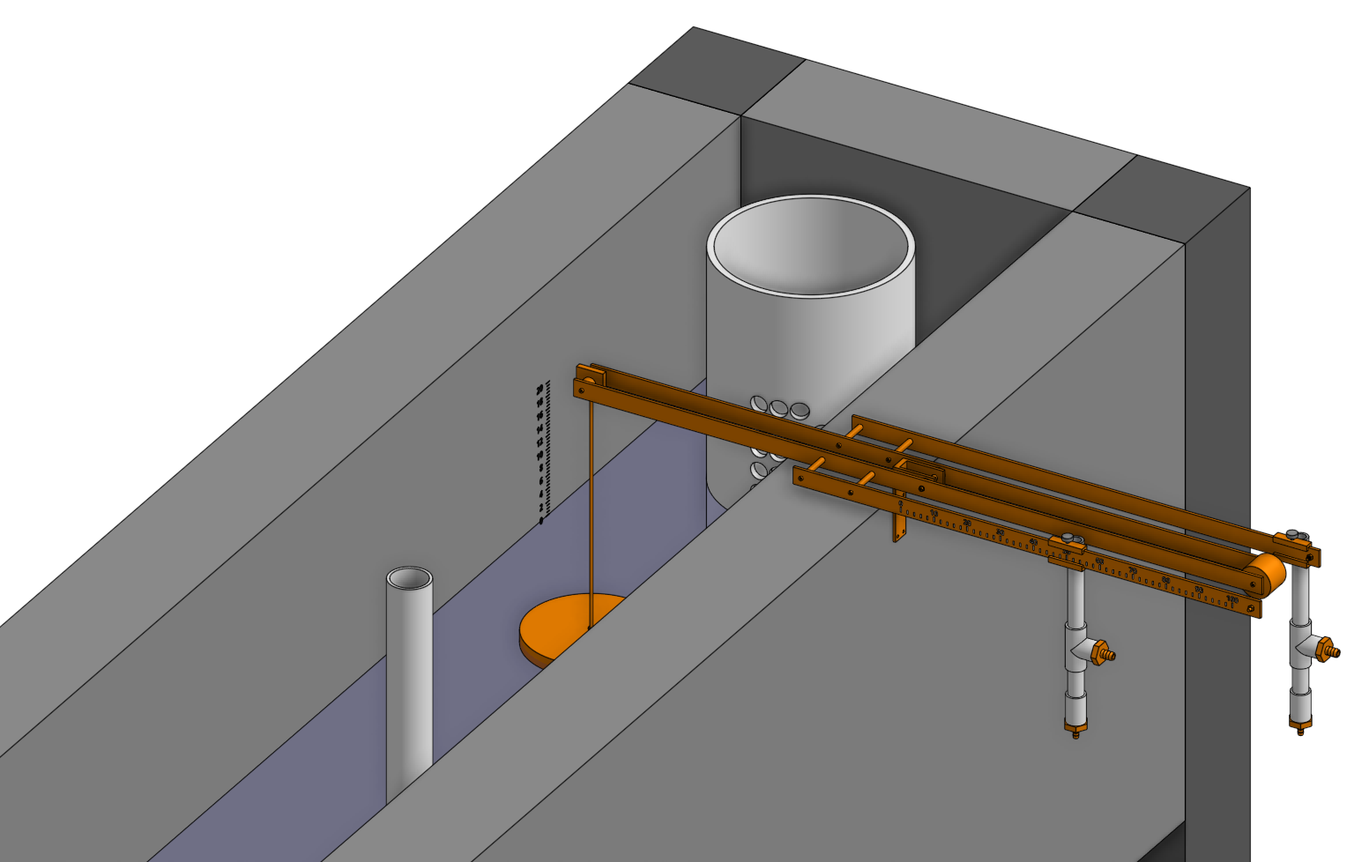
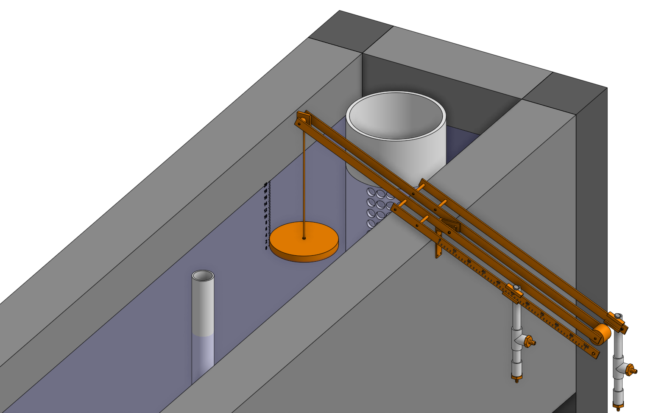
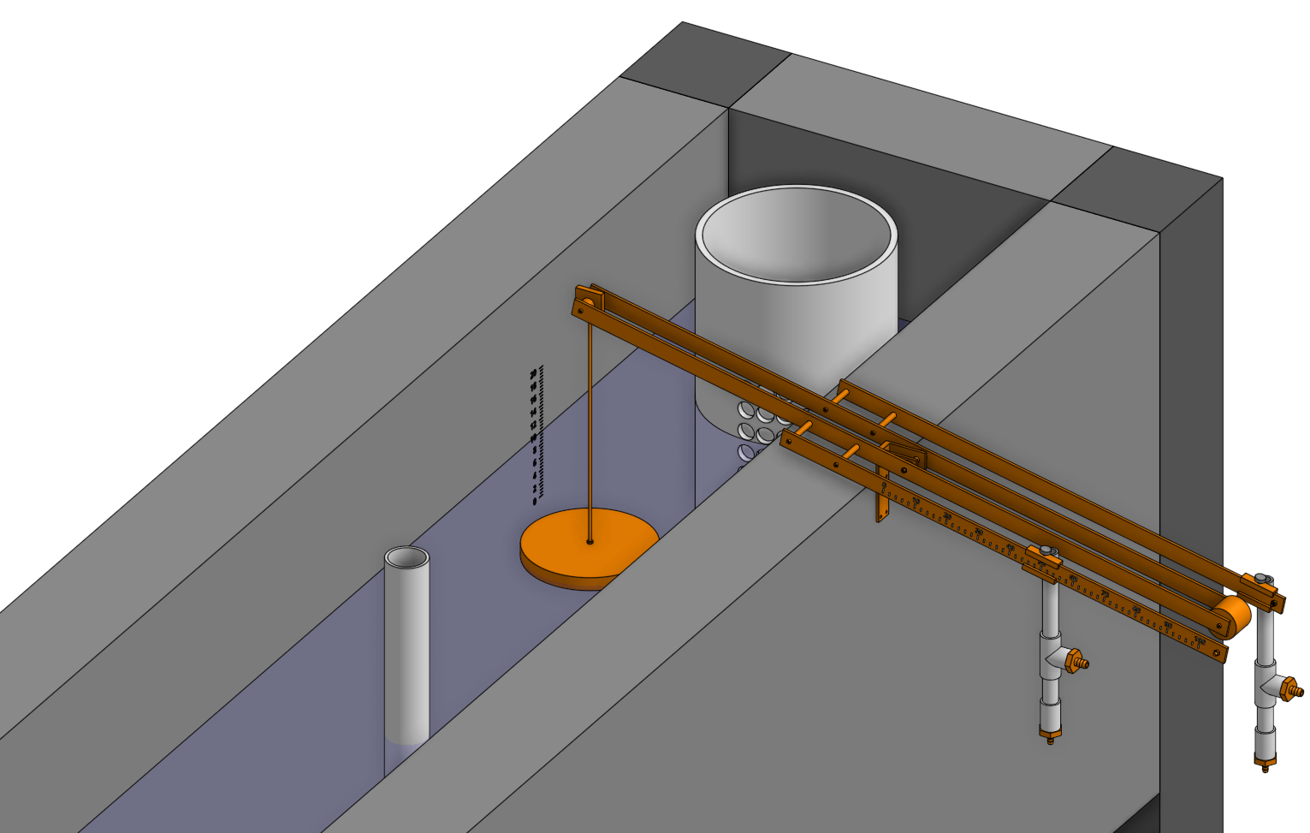

Slide 31
Constant Head: Floats
Head can be varied by changing buoyancy of float
orifice
Supercritical open channel flow!
VERY Flexible hose
Unaffected by downstream conditions!

Slide 32
Hypochlorinator with float design
Overflow tube
Float
Orifice
Transparent flexible tube
Valve
Chlorine drip
Raw water entering distribution tank

Slide 33



Floating Bowl
Creative, but not ideal
Adjust the flow by changing the rocks
Need to make adjustments INSIDE the checmical tank
Rocks are submerged in the chemical
Safety issues

Slide 34


Constant Head: Overflow Tanks
Surface tension effects here
What controls the flow?
Notes:
skip

Slide 35

Constant Head: Marriot bottle
A simple constant head device
Why is pressure at the top of the filter independent of water level in the Marriot bottle?
What is the head loss for this filter?
Disadvantage? ___________
batch system
Notes:
skip

Slide 36
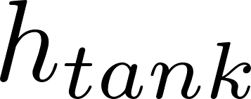
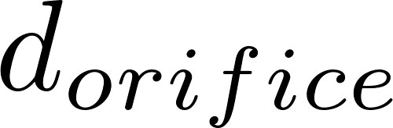
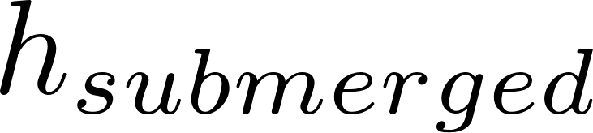
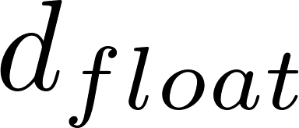
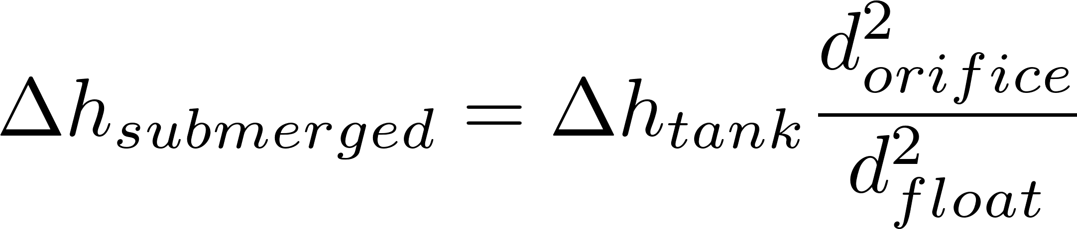
Constant Head: Float Valve
Float adjusts opening to maintain relatively constant water level in lower tank (independent of upper tank level)
NOT Flow Control!
?
Force balance on float valve?
Notes:
Skip

Slide 37
Our goal is to adjust the flowrate and then maintain constant flow
Head (or available energy to push fluid through the flow resistance) (voltage drop)
Flow resistance (resistor)
____________________________________
____________________________________
____________________________________
Vary either the head or the flow resistance to vary the flow rate (current)
Vary head by adjusting the constant head tank elevation or the outlet elevation of a flexible tube
Vary orifice size (flow resistance) by adjusting a valve
Orifice i.e. small hole or restriction
Porous media
Long straight small diameter tube

Slide 38


Float valve and small tube with adjustable head
straight
^
chemical stock tank
Flow control device
If laminar flow Hagen – Poiseuille applies. If we also
neglect minor losses,
Small diameter tubing
h_{L}
Notes:
Peter von Bucher (working at Carollo since 2010 approximately)
Presidential Prez: Alana Jonat
Executive Mastermind: Roslyn Odum

Slide 39
Overview
Entrance Tank
Applications of flow control
If you had electricity
Hole in a bucket
Constant head devices
Floating bowl
Overflow tanks
Marriot bottle
Float valve
Hypochlorinators in Honduras
AguaClara “Almost Linear” Flow Controller
AguaClara Linear Flow Orifice Meter
AguaClara Linear Chemical Dose Controller
Ctrl + click the pictures to go to each section!

Slide 40

Hypochlorinator Fix
What is good?
How could you
improve this system?
What might fail?
Safety hazards?
http://web.mit.edu/d-lab/honduras.htm
Notes:
http://web.mit.edu/d-lab/honduras.htm

Slide 41


AguaClara Technologies
“Almost linear” Flow Controller
Linear Flow Orifice Meter
Linear Chemical Dose Controller

Slide 42
Overview
Entrance Tank
Applications of flow control
If you had electricity
Hole in a bucket
Constant head devices
Floating bowl
Overflow tanks
Marriot bottle
Float valve
Hypochlorinators in Honduras
AguaClara “Almost Linear” Flow Controller
AguaClara Linear Flow Orifice Meter
AguaClara Linear Chemical Dose Controller
Ctrl + click the pictures to go to each section!

Slide 43
AguaClara approach to flow control
Controlled variable head
Float valve creates constant elevation of fluid at inlet to flow control system
Vary head loss by varying elevation of the end of a flexible tube
Head loss element
Long straight small diameter tube
We didn’t realize the necessity of keeping the tube straight until 2012 and thus our early flow controllers had curved dosing tubes

Slide 44
Air vent
Tube from the stock tank
Float valve
0 point is at water level
Holes to choose the dose
Long, “straight,” flexible tube
Raw water
Rapid Mix

Slide 45
Hagen–Poiseuille:
Is only true if, in the “straight” flexible tube,
There is laminar flow
Minor losses can be neglected
In our first flow controllers we didn’t realize how important it was that the flow resistance tube be straight! We ignored minor losses and minor losses weren’t minor!
Raw water

Slide 46


Early Flow Controllers
Nonlinear relationship between flow and height of end of tube because of curved tubing!

Slide 47
Dose Controller: The QC Control Problem
How could we design a device that would maintain the chemical dose (C) as the flow (Q) through the plant varies?
Somehow connect a flow measurement device to a flow controller (lever!)
Flow controller has a (mostly) linear response
Need height in entrance tank to vary linearly with the plant flow rate – solution is The Linear Flow Orifice Meter (LFOM)
Dose is the chemical concentration in the water

Slide 48
Overview
Entrance Tank
Applications of flow control
If you had electricity
Hole in a bucket
Constant head devices
Floating bowl
Overflow tanks
Marriot bottle
Float valve
Hypochlorinators in Honduras
AguaClara “Almost Linear” Flow Controller
AguaClara Linear Flow Orifice Meter
AguaClara Linear Chemical Dose Controller
Ctrl + click the pictures to go to each section!

Slide 49

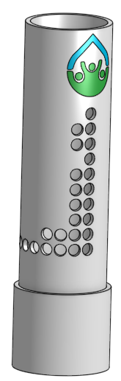
Linear Flow Orifice Meter
Easier to fabricate in the field than the Sutro Weir
Mimics the Sutro weir using a pattern of holes
Install on a section of PVC pipe in the entrance tank
Used at all AguaClara Plants except the first plant (Ojojona)
Invented by AguaClara team member David Railsback, 2007

Slide 50
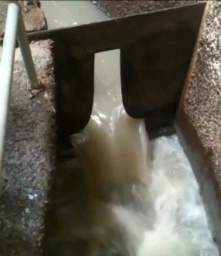
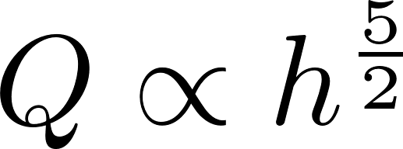
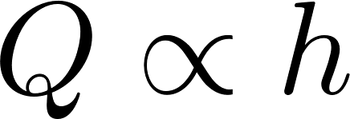

Weir flow-head Proportionality
V-notch
Sutro
Exponent of h is 1, linear!
Rectangular

Slide 51
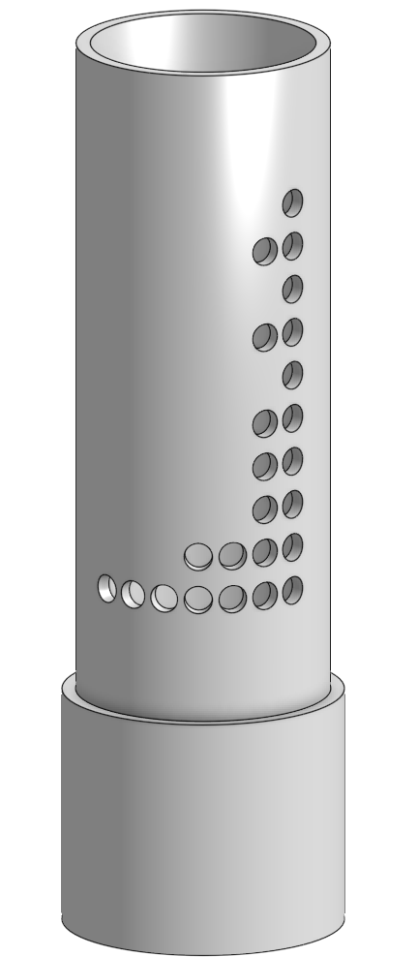
Linear Orifice Meter
Photo by Lindsay France

Slide 52
Overview
Entrance Tank
Applications of flow control
If you had electricity
Hole in a bucket
Constant head devices
Floating bowl
Overflow tanks
Marriot bottle
Float valve
Hypochlorinators in Honduras
AguaClara “Almost Linear” Flow Controller
AguaClara Linear Flow Orifice Meter
AguaClara Linear Chemical Dose Controller
Ctrl + click the pictures to go to each section!

Slide 53

Linear Chemical Dose Controller (CDC)
Combine the linear flow controller and the linear flow orifice meter to create a Linear Dose Controller
Flow of chemical proportional to flow of plant (chemical turns off when plant turns off)
Directly adjustable chemical dose
Can be applied to all chemical feeds (coagulant and chlorine)
Note: This is NOT an automated dose device because the operator still has to set the dose

Slide 54
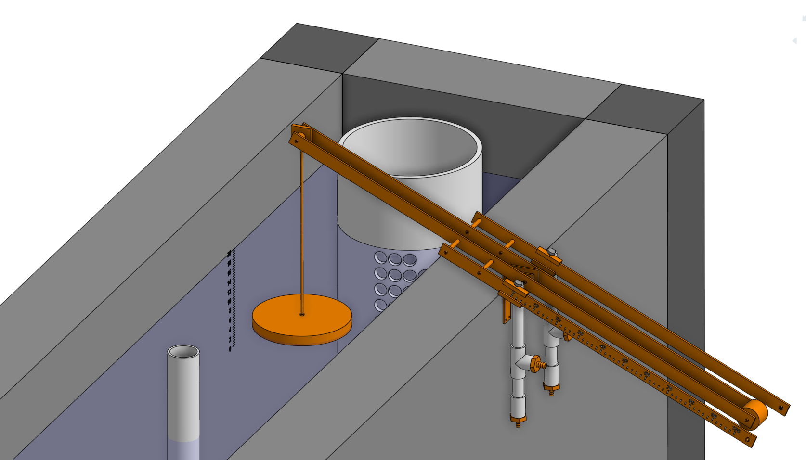
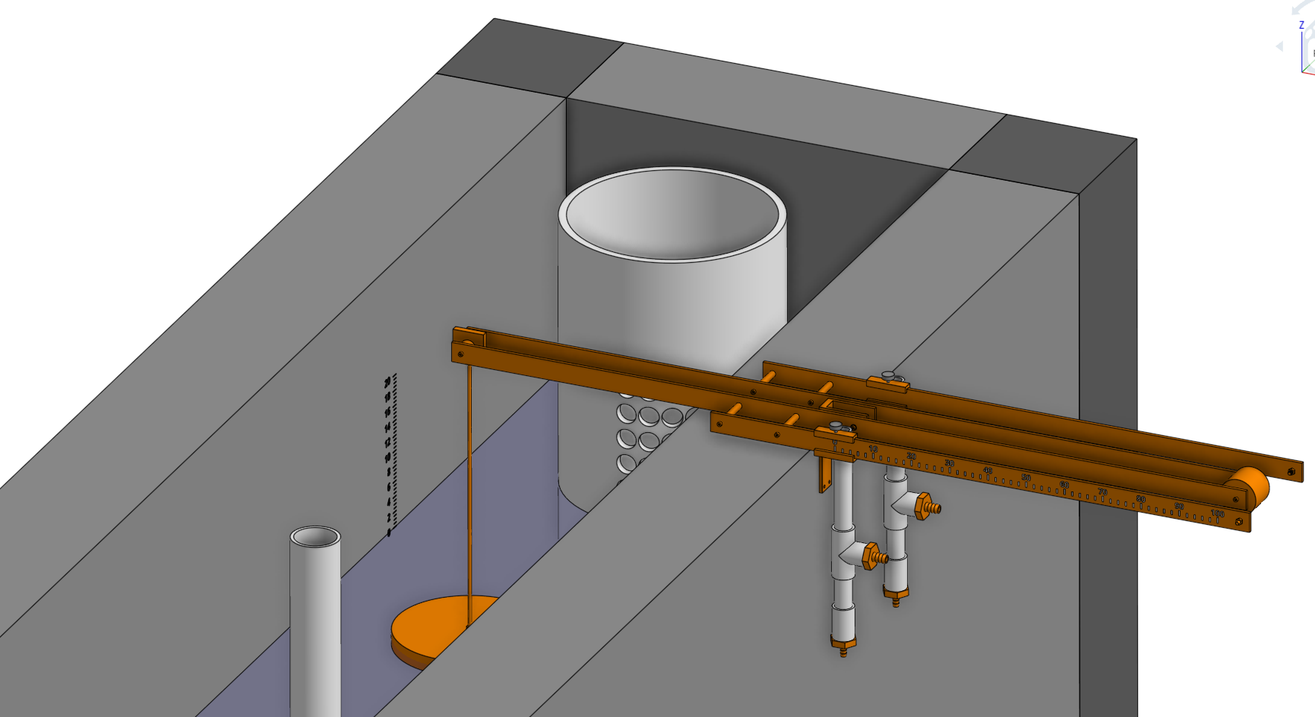
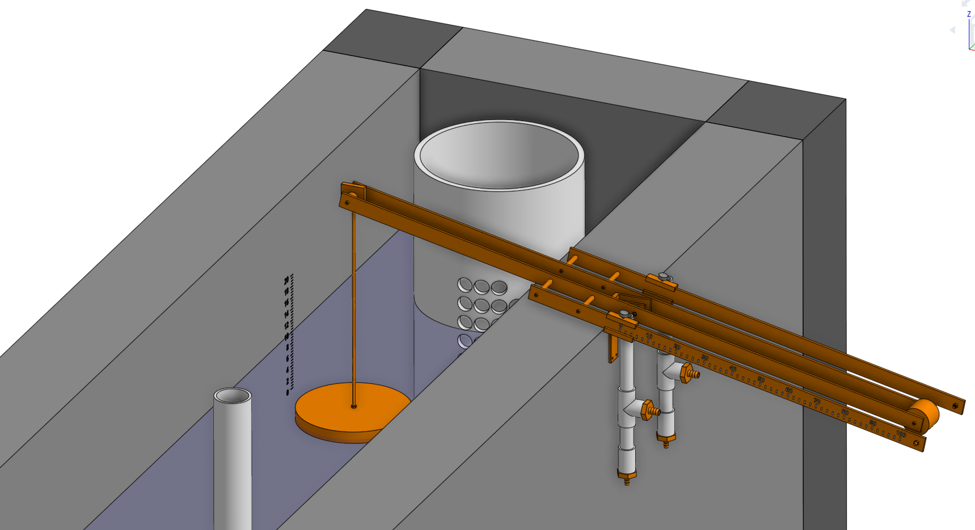

Slide 56
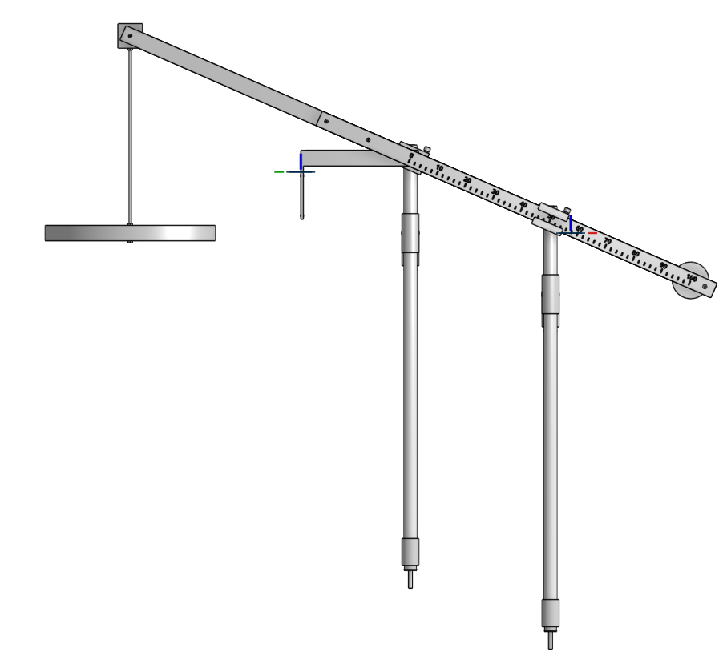
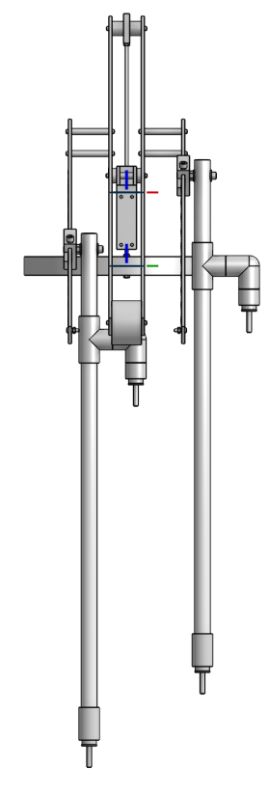
Doser
Sliders
Float
Drop tubes
Connect to doser tubes

Slide 57

Constant level tank
Stock Tank of coagulant
Float valve
Lever
Dose slider
Lever
counterweight
LFOM
Open channel supercritical flow
Float
Drop tube
Dosing tubes
Purge valves
Notes:
This is a basic schematic of what research and design teams have come up with after many years of work. The stock tank holds a stock chemical solution which is connected to a constant head tank. The constant head tank is regulated by a float valve which keeps the chemical depth constant. A large diameter tube leads from the stock tank to one or more small diameter long straight dosing tubes. A large diameter flexible leads to a drop tube with “open channel super critical flow”, where the chemical flows to be added to the plant’s influent water. The drop tube is connected to a lever via a slider. The plant operator sets the slider at the desired coagulant dose based upon characteristics of the influent water. The float attached to the lever changes position as flow rate into the plant changes, thus changing the elevation of the large diameter tube’s outlet, and maintaining a constant chemical dose.

Slide 58
Decrease dose

Slide 59
Increase dose

Slide 60
Notes:
This is a basic schematic of what research and design teams have come up with after many years of work. The stock tank holds a stock chemical solution which is connected to a constant head tank. The constant head tank is regulated by a float valve which keeps the chemical depth constant. A large diameter tube leads from the stock tank to one or more small diameter long straight dosing tubes. A large diameter flexible leads to a drop tube with “open channel super critical flow”, where the chemical flows to be added to the plant’s influent water. The drop tube is connected to a lever via a slider. The plant operator sets the slider at the desired coagulant dose based upon characteristics of the influent water. The float attached to the lever changes position as flow rate into the plant changes, thus changing the elevation of the large diameter tube’s outlet, and maintaining a constant chemical dose.

Slide 61
Half flow

Slide 62
Plant off

Slide 63


Constant Level Tanks
1 for chlorine
1 for coagulant
Spare Constant Head Tanks for when maintenance needs to be done on the originals

Slide 64
1 slider for chlorine
1 slider for coagulant

Slide 65


Slide 66
Linear Flow Orifice Meter
Constant Level Tanks
Lever
Chlorine Dosing Tubes
Coagulant Dosing Tubes

Slide 67
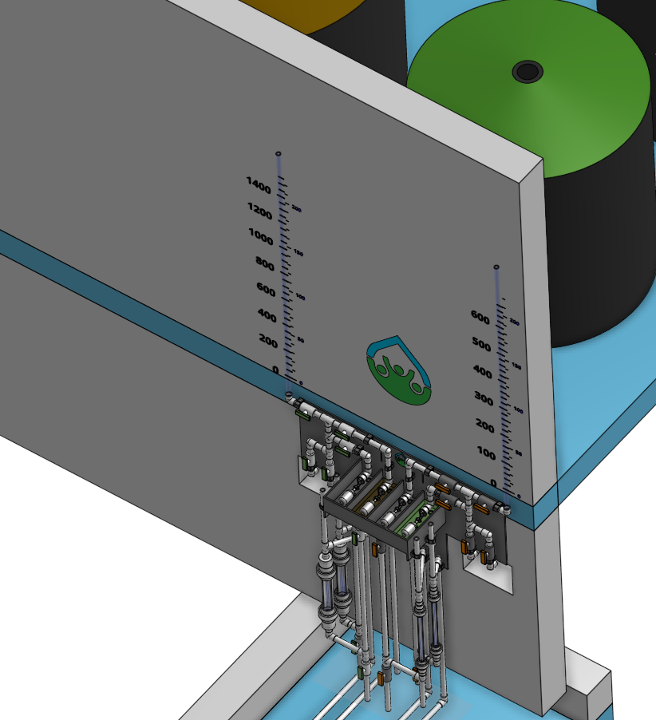
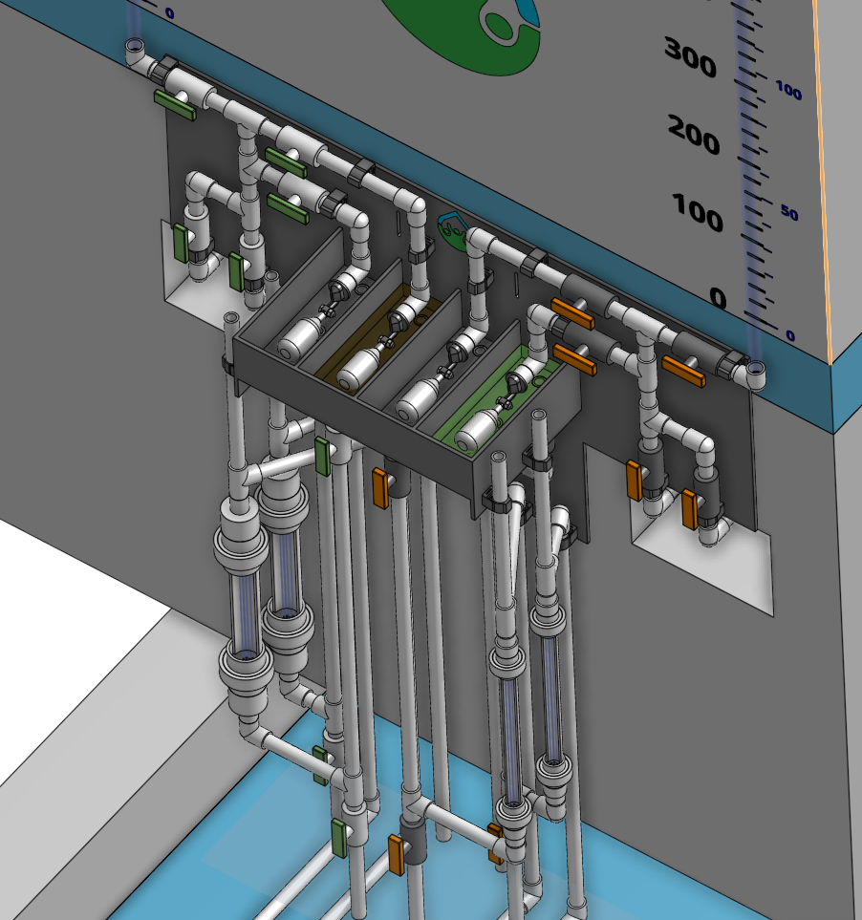
Constant Level Tanks and Dosing Tubes
coagulant tanks
chlorine tanks

Slide 68
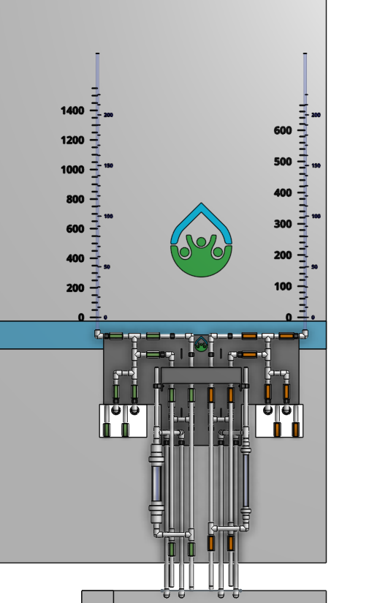
Constant Level Tanks and Dosing Tubes
Dual purpose calibration columns
Show level in stock tank
Measure flow of chemical
Air vents to facilitate initial filling and cleaning
Dosing tubes are vertical with flow from bottom to top to easily remove air bubbles

Slide 69
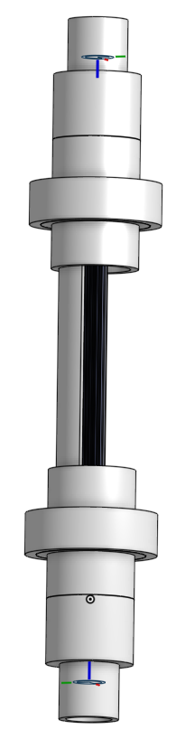
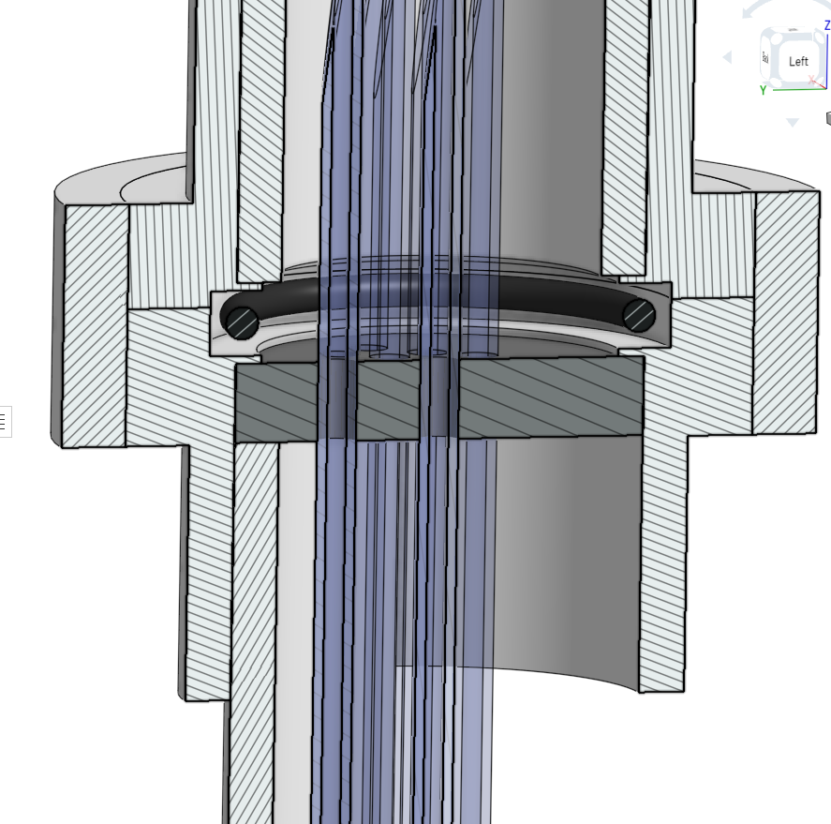
Proposed new Dosing Tube Design
Dosing tube ends cut on angle so they can be pulled through small holes in disc to create a liquid tight seal
Union
PVC disc with holes that are slightly smaller than the OD of the dosing tubes (glued into the union)
Dosing tube
PVC pipe cut in half. Holds dosing tubes taut and provides protection

Slide 70
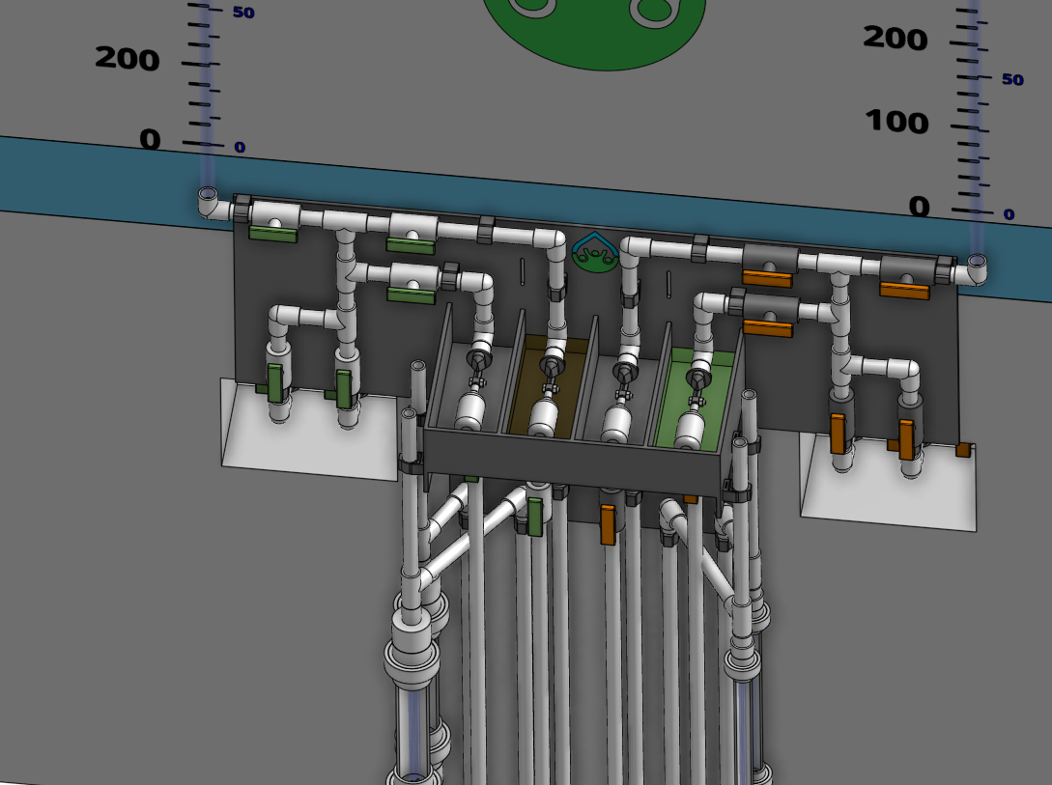
Redundant design with duplicate paths for chemicals to flow
Select float/dosing tube
Select stock tank
Air release vents

Slide 71


Slide 72

Atima doser: Three 1/8” diameter tubes, 1.93 m long, 187.5 g/L stock solution of PACl, 5 to 48 mg/L dose range
Coagulant Stock Tank
Flow calibration column
Lever
Constant Level Tank
Linear Flow Orifice Meter
Dosing Tubes
Notes:
Dosificador: 3 mangueras de 1/8" diámetro interno, 1.93m longitud, concentración madre de 187.5 g/L de PAC, dosis máxima 48 mg/L, dosis mínima 5 mg/L.

Slide 73

Linear Chemical Dose Controller (CDC): A key technology for high performing plants
The operator sets the dose directly
No need for calculations
Visual confirmation
More improvements are possible!
Make it modular
Prevent air bubbles from blocking flow
Make it easier to remove calcium carbonate scale

Slide 74




Design specifications for the float valve
Chemical Feed Tank
The float valve has an orifice that restricts the flow of the chemical and that dominates the head loss between stock tank and constant head tank. Different float valves have different sizes of orifices.
Why not increase Δh?
Why are we concerned with the orifice head loss?
Where else is there head loss?
Is this a minimum or a maximum orifice diameter?
Notes:
We must also design the tubing diameter that delivers the chemical to the constant head tank
If the orifice head loss is too large the float valve will end up controlling the flow rate when the stock tank begins to empty.
This is the minimum orifice diameter. Larger would be okay.
We could increase deltah, but that raises the stock tank and the plant operator has to fill this stock tank and climb stairs to get to it.

Slide 75
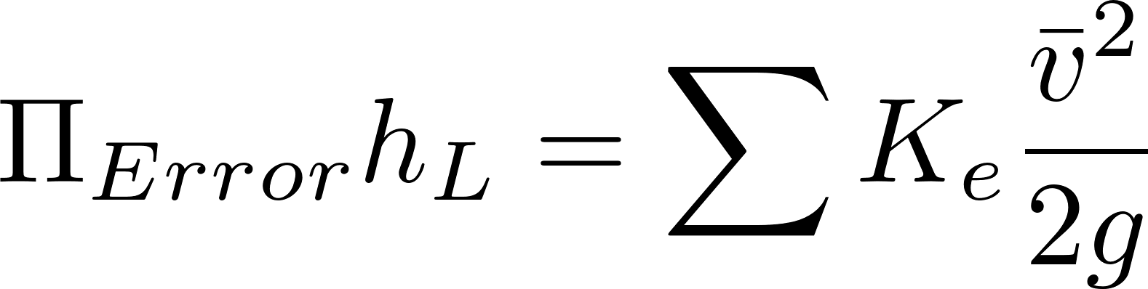
Constraints on flow controller dosing tube design
Flow must be laminar (Re<2100)
Minor losses must be small (small V!)
It took us a while to discover how critical this constraint is!
Use oversized barbed fittings! (watch out for contractions!)
Dosing tube must “be reasonable” length which might mean shorter than an available wall in the plant.
Designing dose controllers over a wide range of chemical flow rates requires good engineering (we are still working on this!)
How can I get a shorter tube?
Notes:
Get a shorter tube by using a smaller diameter tube. May need to use multiple smaller diameter tubes.

Slide 76



Making the CDC linear: minimizing minor losses
Calibrate at max flow
Simple linear model
Neglecting minor losses
Reality

Slide 77

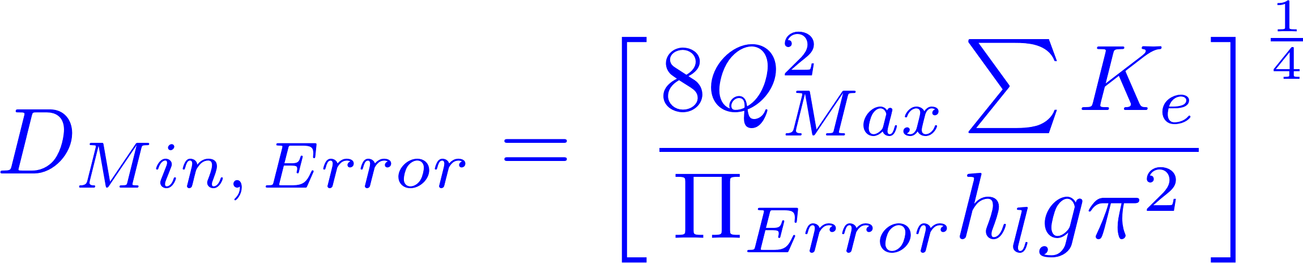




CDC dosing tubes: diameter constraints

Slide 78


CDC dosing tubes: length constraints
Notes:
If the tube isn’t operating at the maximum flow possible for that tube, then it needs to be made even longer to generate the target head loss.

Slide 79

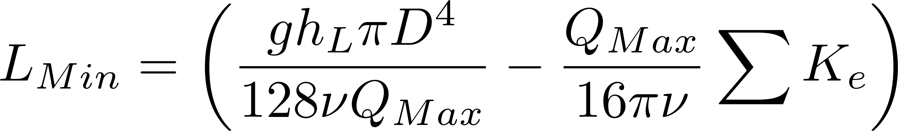
CDC Design Algorithm
Click here to get the full design and derivation
Calculate the maximum flow rate through each available dosing tube diameter that keeps error due to minor losses below 10%.
Calculate the total chemical flow rate that would be required by the treatment system for the maximum chemical dose and the maximum allowable stock concentration.
Calculate the number of dosing tubes required if the tubes flow at maximum capacity (round up)
Calculate the length of dosing tube(s) that correspond to each available tube diameter.
Select the longest dosing tube that is shorter than the maximum tube length allowable based on geometric constraints.
Select the dosing tube diameter and flow rate corresponding to the selected tube length.
Notes:
https://confluence.cornell.edu/download/attachments/77267239/LCDC_ASCE.pdf?version=1&modificationDate=1345649734000

Slide 80

Dose Controller Accuracy
Float valves greatly reduce the magnitude of the fluctuations in level (constant level tanks aren’t truly constant level!)
Surface tension effects at the location where the fluid switches from closed conduit to open channel flow (the end of the dosing tube) could cause errors of a few millimeters
The weight of the tubing and slide supported by the lever will apply different amounts of torque to the lever depending on the dose chosen. This determines the required diameter of the float

Slide 81




Maximum Plant Flow Rate Using Linear Flow Controller
Assume the PACl concentration is 160 g/L, the maximum PACl dose is 30 mg/L, and the maximum flow in a 5 mm diameter dosing tube is about 8.7 mL/s.
P = Plant
C = Chemical Feed
Mass conservation
Multiple tubes
What is the solution for larger plants? ___________
Notes:
We could use a single PVC pipe that is then filled with 5 mm diameter tubes so that there is only one plumbing connection.

Slide 82
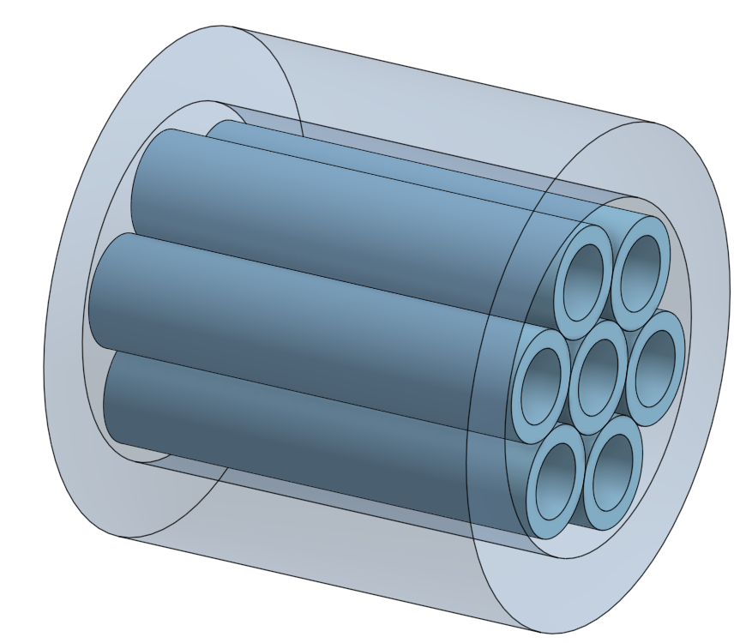
Opportunities to Improve the Dose Controller
Make it easier to clean (perhaps clean in place)
Bundle of dosing tubes inside a pipe to make a single unit that can handle high flow rate while maintaining laminar flow
A honeycomb structure would be cool
Must be compatible with chlorine
Chemicals will flow on the outside of the dosing tubes too!

Slide 83
Dose Control Summary
Laminar tube flow and linear flow orifice meters
Need a new LFOM design for flow rates above about 100 L/s to avoid using very large pipes
Need a new doser tube design for when multiple tubes are required
These devices are robust AND a good design requires excellent attention to details
No small parts to lose
No leaks
Compatible with chlorine (watch out for the O-rings in PVC valves)
Locally sourced materials if possible
Dosing tubes must be straight
Must account for viscosity of the chemical
Minor losses must be minor!
Removing calcium carbonate scale must be easy
Must have redundancy for ease of maintenance

